Slide 1
What is Trauma-Informed Care?

Slide 2
What is Trauma-Informed Care?
Takes the patient’s experience of trauma into account
Instead of asking “What’s wrong with you?” asks “What happened to you?”
Must be clinical AND organizational
Trying to implement trauma-specific client practices without first implementing trauma-informed organizational culture change is like throwing seeds on dry land
-Sandra Bloom, MD, creator of the Sanctuary Model

Slide 3
Core Principles of a Trauma-Informed Approach
Safety
Throughout the organization, patients and staff feel physically and psychologically safe
Trustworthiness & Transparency
Decisions are made with transparency, and with the goal of building and maintaining trust
Peer Support
Individuals with shared experiences are integrated into the organization and viewed as integral to service delivery
Collaboration
Power differences — between staff and clients and among staff — are leveled to support shared decision-making
Empowerment
Patient and staff strengths are recognized, built on, and validated — this includes a belief in resilience and the ability to heal from trauma
Humility & Responsiveness
Biases and stereotypes and historical trauma are recognized and addressed

Slide 4
Key Ingredients of Trauma-Informed Care
ORGANIZATIONAL
CLINICAL
Lead and communicate about the transformation process
Engage patients in organizational planning
Train clinical as well as non-clinical staff members
Create a safe environment
Prevent secondary traumatic stress in staff
Hire a trauma-informed workforce
Involve patients in the treatment process
Screen for trauma
Train staff in trauma-specific treatment approaches
Engage referral sources and partner organizations

Slide 5
1. Lead and Communicate about the Transformation Process
KEY INGREDIENTS OF TRAUMA-INFORMED CARE
Engage senior leadership
Communicate the importance and value of TIC to generate staff buy-in
Ensure that both staff and patients understand why changes will be made to how the organization functions
Successful transformation will require investments, including:
Training time for staff
Technical assistance
Making physical modifications to the facility

Slide 6
KEY INGREDIENTS OF TRAUMA-INFORMED CARE
2. Engage Patients in Organizational Planning
Invite patients with lived experience of trauma to join stakeholder committees
Consider compensating patients and community members for their time

Slide 7
3. Train Clinical as well as Non-Clinical Staff Members
KEY INGREDIENTS OF TRAUMA-INFORMED CARE
All staff should be well-versed in how to create a welcoming, trusting, non-threatening environment
Non-clinical staff (e.g., front-desk workers, security guards, drivers, etc.) play a key role in patient engagement. They interact with patients first, and more often than clinical providers

Slide 8
4a. Create a Safe Physical Environment
KEY INGREDIENTS OF TRAUMA-INFORMED CARE
Keep parking lots, common areas, bathrooms, entrances, and exits well-lit
Keep noise levels in waiting room low
Use welcoming language on all signage
Make sure patients have clear access to the door in exam rooms and can easily exit if desired

Slide 9
4b. Create a Safe Social-Emotional Environment
KEY INGREDIENTS OF TRAUMA-INFORMED CARE
Welcome patients and ensure that they feel respected and supported
Ensure that staff maintain healthy interpersonal boundaries and can manage conflict appropriately
Maintain consistent schedules and procedures
Practice cultural humility and responsiveness with staff and patients

Slide 10
5. Prevent Secondary Traumatic Stress in Staff
KEY INGREDIENTS OF TRAUMA-INFORMED CARE
Provide trainings that raise awareness of secondary traumatic stress
Offer opportunities for staff to explore their own trauma histories
Support reflective supervision, in which a service provider and supervisor meet regularly to address feelings regarding patient interactions
Encourage and incentivize physical activity, yoga, and meditation
Allow staff to take “mental health days”

Slide 11
6. Hire a Trauma-informed Workforce
KEY INGREDIENTS OF TRAUMA-INFORMED CARE
Graduate programs do not yet incorporate trauma-informed principles into curricula
Organizations can hire staff with personality characteristics well suited for trauma-informed work
Hiring managers can use behavioral interviewing to screen for empathy, non-judgment, and collaboration

Slide 12
7. Involve Patients in the Treatment Process
KEY INGREDIENTS OF TRAUMA-INFORMED CARE
Engage patients in treatment planning with an empowered role in decision-making
Build on patient strengths an resources in the development of treatment goals
Use peer support workers who have lived trauma experience to build patient trust and engagement

Slide 13
8. Screen for Trauma
KEY INGREDIENTS OF TRAUMA-INFORMED CARE
Differing views exist on when and how to screen for trauma
Consensus around the following aspects of screening:
Treatment setting should guide screening practices
Screening should benefit the patient
Re-screening should be avoided
Provide ample training before implementing screening

Slide 14
9. Train Staff in Trauma-Specific Treatment Approaches
KEY INGREDIENTS OF TRAUMA-INFORMED CARE
Select Adult-Focused Models:
Prolonged Exposure Therapy (PE Therapy)
Eye Movement Desensitization and Reprocessing (EMDR)
Seeking Safety
Select Child-Focused Models:
Child-Parent Psychotherapy
Attachment, Self-Regulation, and Competency (ARC)
Trauma-Focused Cognitive Behavioral Therapy (TF-CBT)

Slide 15
10. Engage Referral Sources and Partner Organizations
KEY INGREDIENTS OF TRAUMA-INFORMED CARE
Work with community partners and within a system of care to develop a trauma-informed referral network
Opportunities to engage potential referral sources include:
Inviting them to participate in internal training
Hosting community-wide trauma-informed care training efforts
Encouraging patients serving on the advisory board to lobby community-based organizations to become trauma-informed

Slide 16
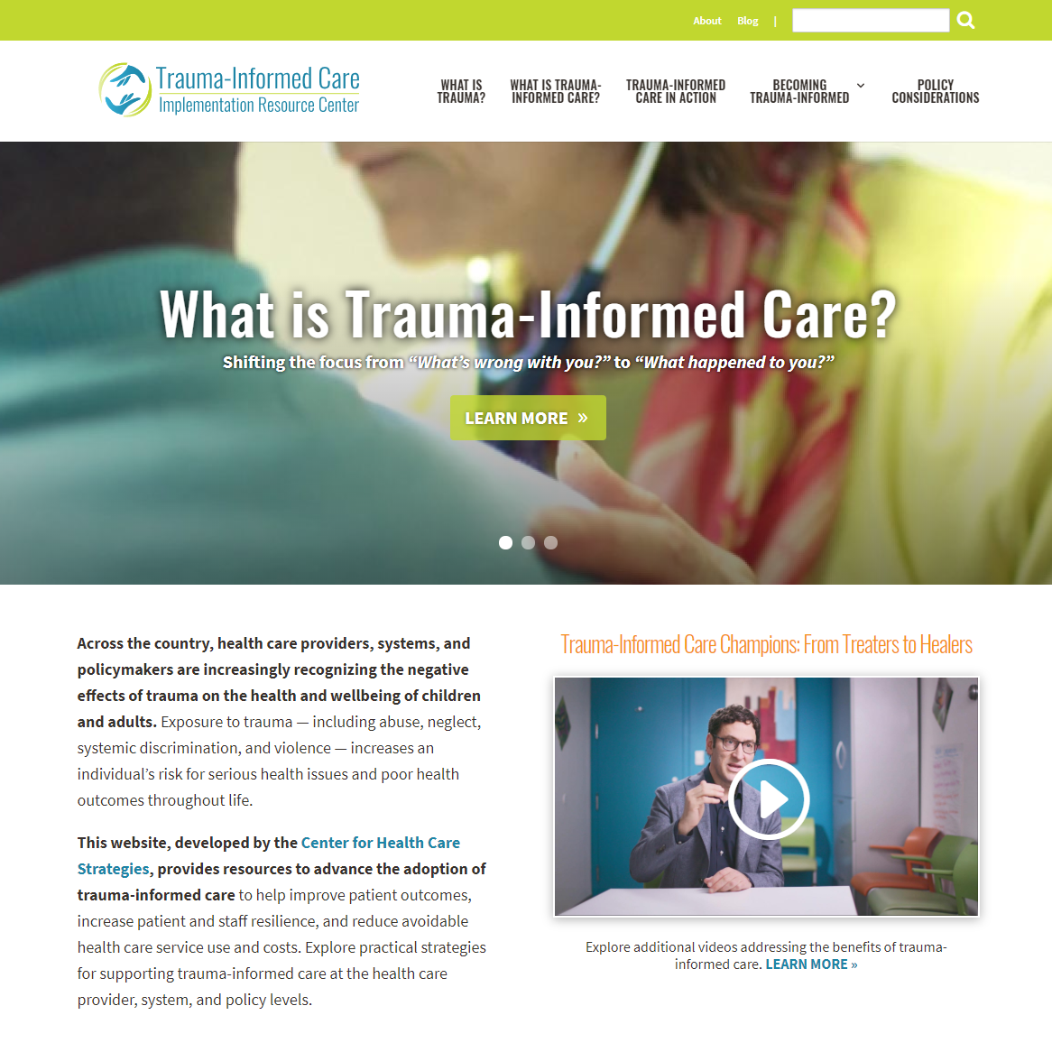
Learn More
This presentation is a product of Advancing Trauma-Informed Care, a national initiative focused on better understanding how trauma-informed approaches can be practically implemented across the health care sector, made possible by the Robert Wood Johnson Foundation and led by the Center for Health Care Strategies (CHCS). CHCS is a nonprofit policy center dedicated to improving the health of low-income Americans.
For more information, visit CHCS’ Trauma-Informed Care Implementation Resource Center at TraumaInformedCare.chcs.org.

